Slide 1
Project Time Management
Strategic and Stakeholders’ Needs
Knowledge Areas
Core Functions
Scope
Management
Time
Management
Cost
Management
Quality
Management
Project
Success
Project Integration Management
& Stakeholder Management
Human Resource
Management
Communications
Management
Risk
Management
Procurement
Management
Facilitating Functions

Slide 2
Precedence Diagramming Method
PDM
The precedence diagramming method (PDM) is a technique used for constructing a schedule model in which activities are represented by nodes and are graphically linked by one or more logical relationships to show the sequence in which the activities are to be performed.
Activity-on-node (AON) is one method of representing a precedence diagram, commonly used by software packages. It is used in network diagram for construction-oriented projects, and they use deterministic approach.
Activity-on-Arrow (AOA):is used in network diagram for R&D projects and they use probabilistic approach.

Slide 3
Network Diagram: Techniques
1. CPM(Critical Path Method, used for construction projects, activities are represented on Node, follows Deterministic approach
2. . PERT(Performance Evaluation and Review Technique), used for R&D projects, activities are represented on Arrows, follows Probabilistic approach, means time/duration for each activity is calculated based on formula using Most likely time, b; Optimistic time, a; and Pessimistic time, c.
Activity duration, t= (a+4b+c)/6

Slide 4
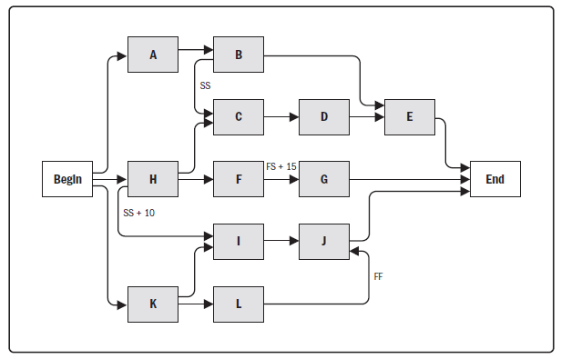
Project Schedule Network Diagram

Slide 5
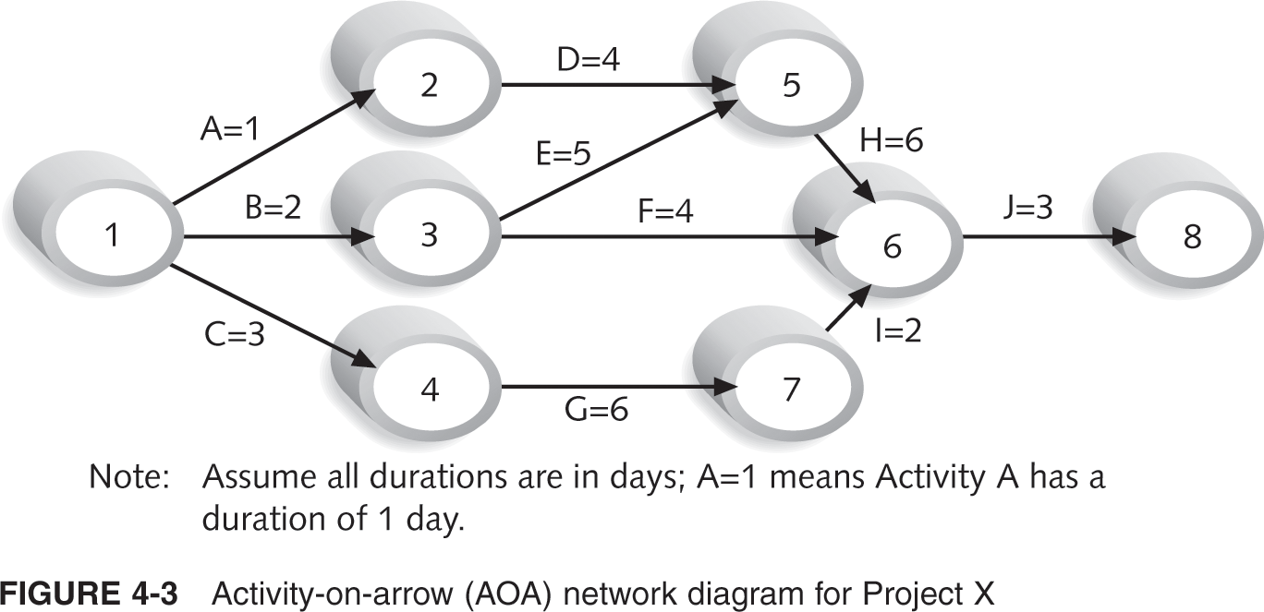
Activity-on-Arrow (AOA) Network Diagram for Project X

Slide 6
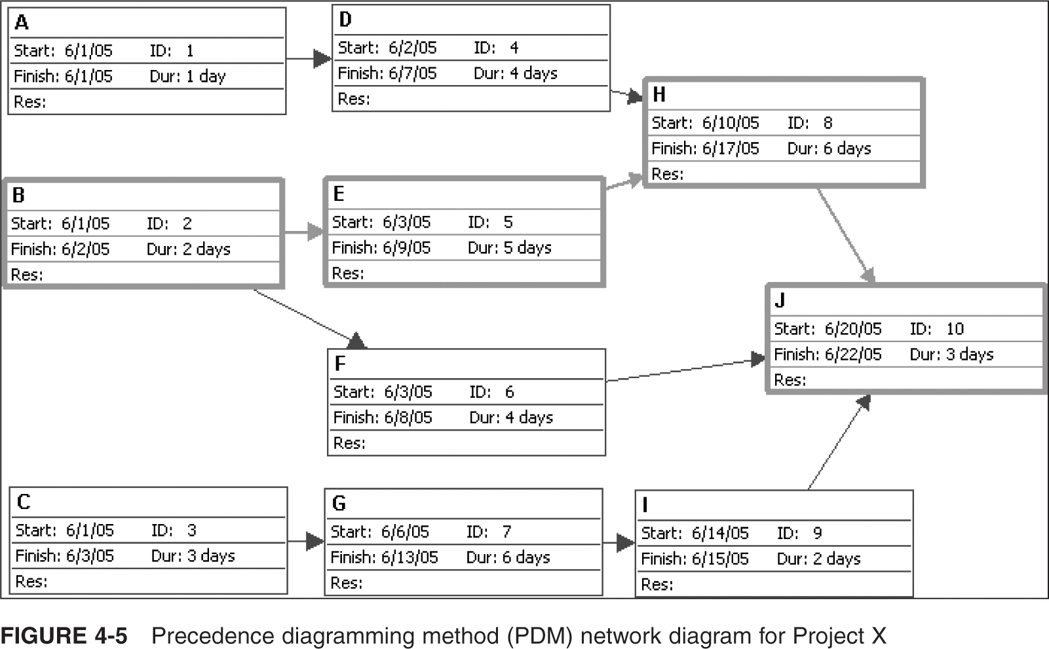
Network Diagram for Project X

Slide 7
Critical Path
Critical Path
A critical path for a project is the series of activities that determine the earliest time by which the project can be completed.
It is the longest path through the network diagram and has the ZERO slack or float.
Slack or float
A slack or float is the amount of time an activity may be delayed without delaying a succeeding activity or the project finish date.
The longest path or the path containing the critical tasks is what is driving the completion date for the project.

Slide 8
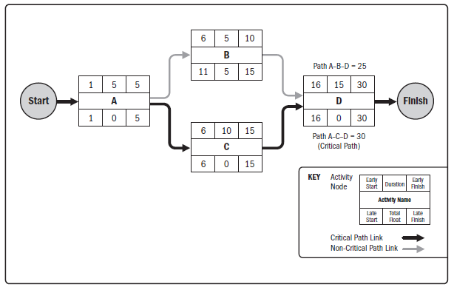
Example of Critical Path Method

Slide 9
Slack= Late start- early start
Early finish= Early start+ duration, for B, 5+5=10
Late start= Late finish- Duration, for B, 15-5=10
For activity A, Slack= 0-0=0
For activity B, Slack= 10-5=5
It means, activity A has no option to make delay as slack is 0, if it is delayed project completion time will also be delayed.
But Activity B can be delayed by 5 days as slack is 5 and it will have no impact on project completion time.
So, Activity A is critical and activity B is non-critical.

Slide 10
Path-1: A-B-D, Duration of this path= 5+5+15=25 days
Path-2: A-C-D, Duration of this path= 5+10+15=30 Days
Since, all the activities in Path-2 are critical, so Path-2 is Critical Path.
But, in Path-1, Activity B is non-critical so Path-1 is Non-Critical path.
A-C-D is the longest path and it is the critical path, although this path is the longest but as it has no non-critical activities, this path should be followed to complete the project.
Completion time of this project is 30 Days.

Slide 11
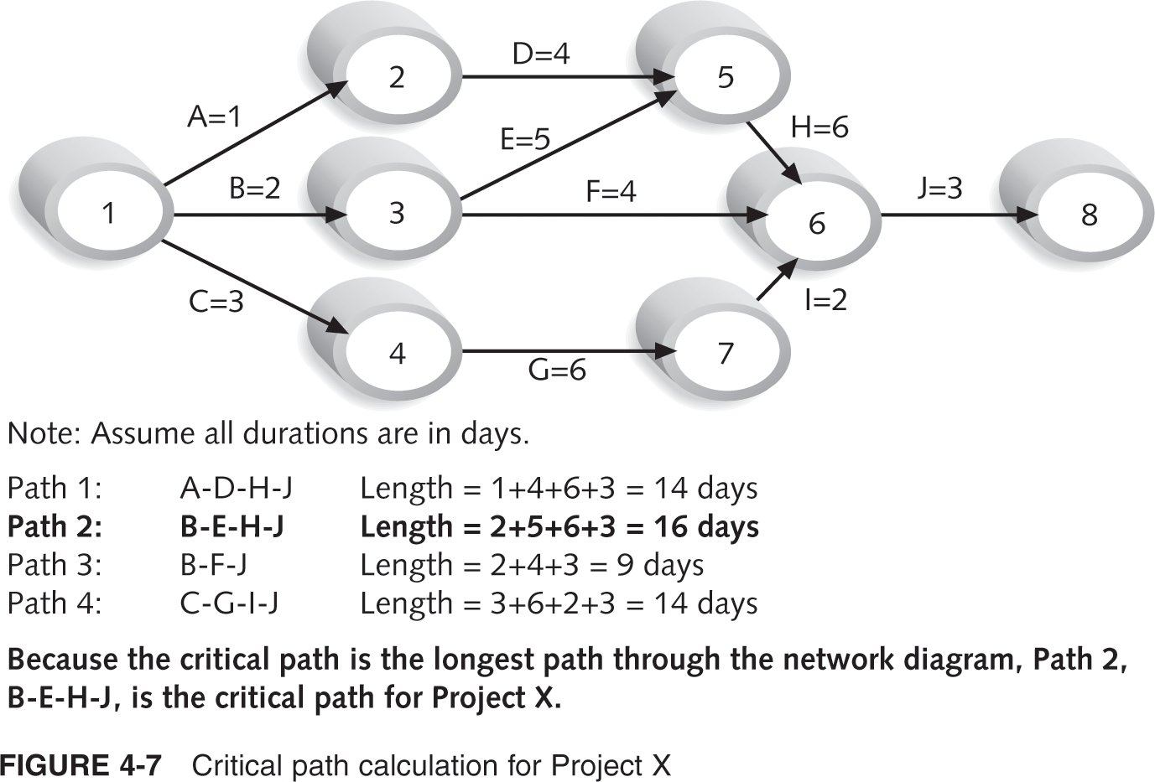
Critical Path Calculation for Project X

Slide 12
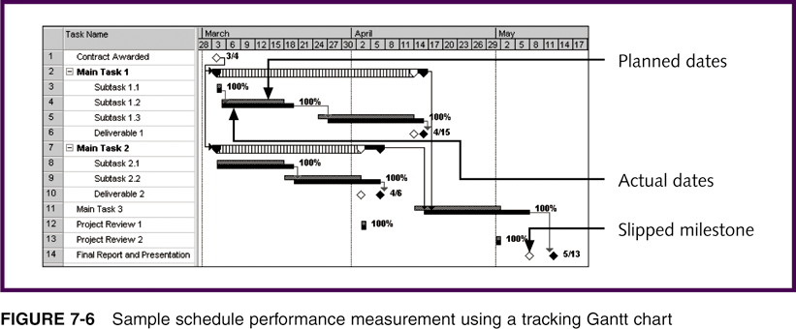
Sample Schedule Performance Measurement Using a Tracking Gantt Chart

